Slide 1
CA LAB 3

Slide 2
Serial Monitor
The Arduino IDE has a feature that can be a great help in debugging sketches or controlling Arduino from your computer's keyboard. The Serial Monitor is a separate pop-up window that acts as a separate terminal that communicates by receiving and sending Serial Data.

Slide 3
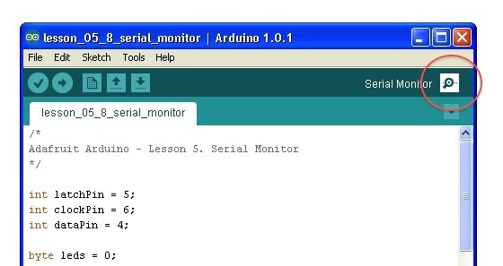
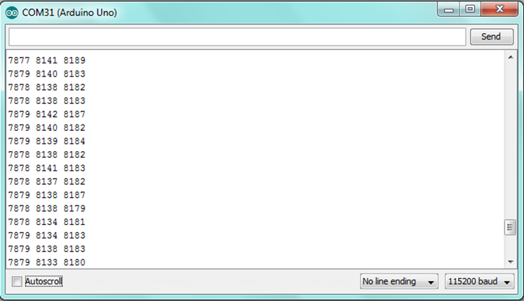
Serial Monitor

Slide 4
Baud Rate
The baud rate is the rate at which information is transferred in a communication channel. Baud rate is commonly used when discussing electronics that use serial communication. In the serial port context, "9600 baud" means that the serial port is capable of transferring a maximum of 9600 bits per second.

Slide 5
Serial Commands
Serial.begin(9600); // opens serial port, sets data rate to 9600 bps
Serial.print(“ABc21 "); // To print any message on Serial monitor
Serial.println(incomingByte, DEC); //To print any data on serial monitor on next line
Serial.available();// Get the number of bytes (characters) available for reading from the serial port.

Slide 6
Serial Commands
Serial.availableForWrite();// Get the number of bytes (characters) available for writing in the serial buffer without blocking the write operation.
Serial.read();// Reads incoming serial data.

Slide 7
Displays for Arduino
The Arduino board has a wide variety of compatible displays that you can use in your electronic projects. In most projects, it’s very useful to give the user some sort of feedback from the Arduino.
Whether it’s a sensor reading, an ok message or to create an interface to interact with your Arduino board.

Slide 8
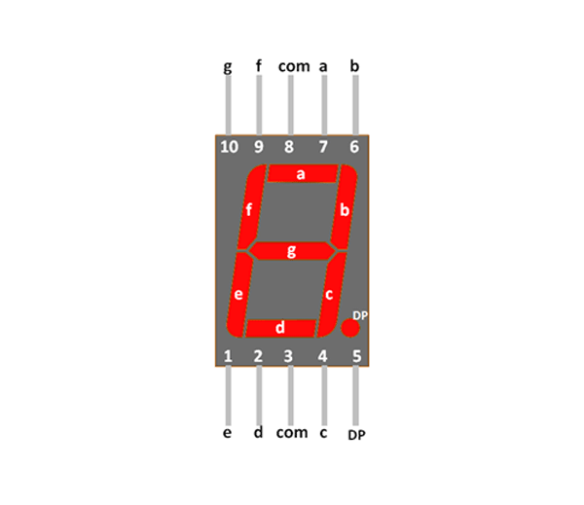
7-segment
Displaying of number using 7-segment display.
Connect driver or circuit with arduino and arduino will give signals to display the required number

Slide 9
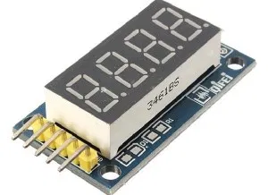
4 Bits Digital Tube LED display
This display allows you to display 4 digits with seven segments. It’s useful to display data from a temperature sensor, for example.

Slide 10
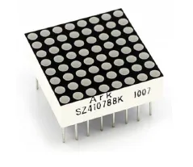
Dot matrix
The dot matrix has 64 leds, 8×8. You can control each led individually to display letters, numbers, figures, etc.
You can attach several dot matrices, to have a bigger area.

Slide 11
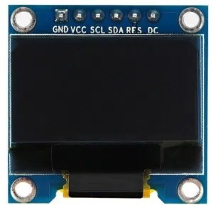
White OLED display
This is a tiny display with just 1 x 0.96 Inch. This display has a black background, and displays characters in white. There are other similar displays that can show the characters in other colors.

Slide 12
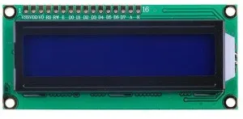
16×2 character LCD display
This usually the first display most people use when they first start using the Arduino board.
It displays 16 characters in 2 rows (there are also other sizes available). These displays come with a blue or green background and with a backlight.

Slide 13
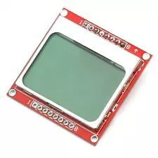
5110 LCD display
These are the kind of displays used in old Nokia cellphones.
The background is grey and the characters or pictures are displayed in darker grey. They are very cheap and easy to use.

Slide 14
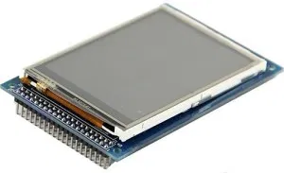
TFT LCD display
With the TFT display you can display colorful images or graphics. This module has a resolution of 480 x 320. This module includes the SD card socket and SPI FLASH circuit.

Slide 15
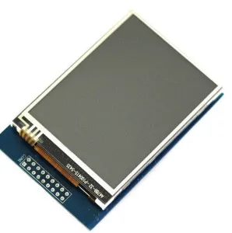
TFT LCD touchscreen display
This module is similar to the TFT LCD display, but it has touchscreen.

Slide 16
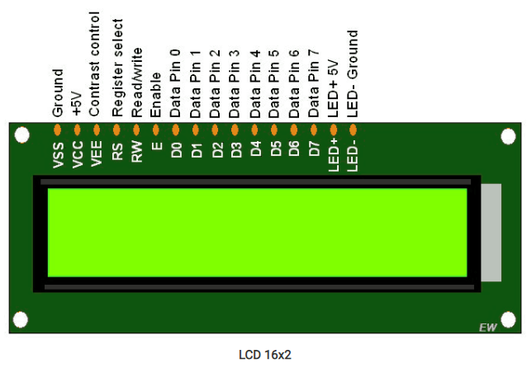
LCD Display (16x2)

Slide 17
LCD Display(16x2)
LCDs (Liquid Crystal Displays) are used in embedded system applications for displaying various parameters and status of the system.
LCD 16x2 is a 16-pin device that has 2 rows that can accommodate 16 characters each.
LCD 16x2 can be used in 4-bit mode or 8-bit mode.
It is also possible to create custom characters.
It has 8 data lines and 3 control lines that can be used for control purposes.

Slide 18
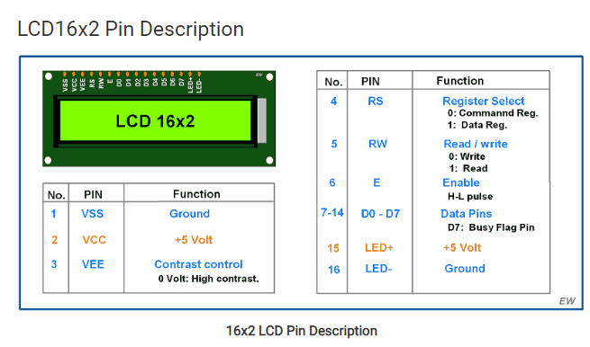

Slide 19
INTRODUCTION TO I2C COMMUNICATION
I2C combines the best features of SPI and UARTs. With I2C, you can connect multiple slaves to a single master (like SPI) and you can have multiple masters controlling single, or multiple slaves.
Like UART communication, I2C only uses two wires to transmit data between devices:
SDA (Serial Data) – The line for the master and slave to send and receive data.
SCL (Serial Clock) – The line that carries the clock signal.

Slide 20
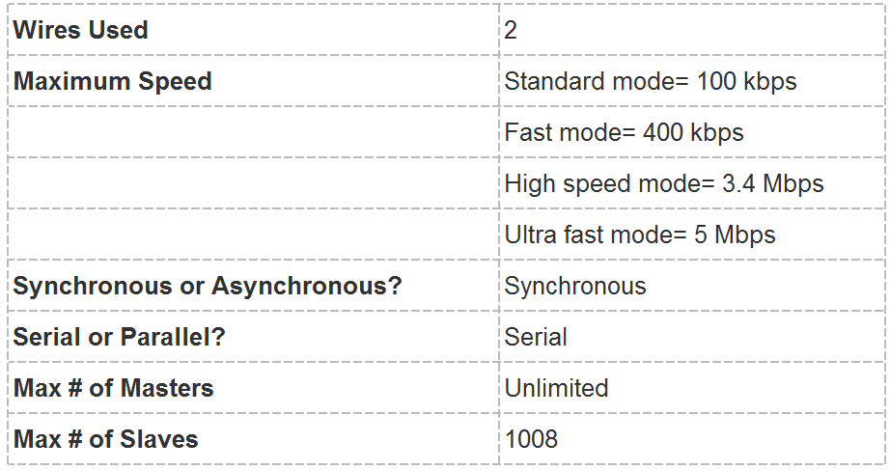

Slide 21
